Slide 1
Employers Supporting RFS Volunteers

Slide 2
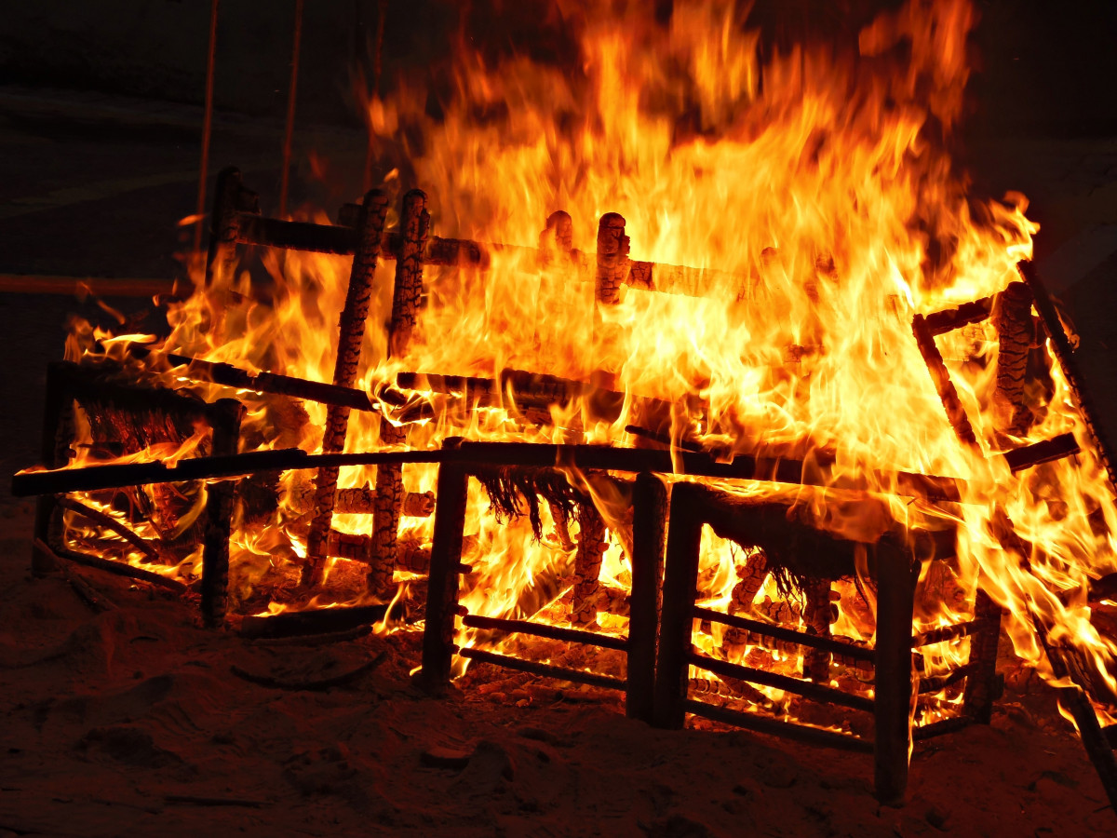
About the Rural Fire Service
The Rural Fire Service (RFS) is made up of about 28,000 volunteers, who form more than 1,400 Rural Fire Brigades (RFBs).
Brigades around the state provide essential services to the people of their community and deliver fire and incident response coverage to 93% of the state.
Notes:
RFBs may vary in the character and operational method they deliver under, but, they all have the same primary goal,
- To protect the people and assets of their community against the destructive forces of nature which causes impacts in many forms.

Slide 3

RFB Responsibilities
Fighting fires
Fire prevention
Community education
Permits to light fire
Deployments and assistance.
Notes:
Fighting Fires – responding to the outbreak of fires within their local community, and responding to support neighbouring brigades response capability.
Fire Prevention – Brigades, in conjunction with RFS staff, Undertake a range of planning and preparation activities throughout the year, to ensure communities are well prepared for the fire season.
- One typical activity is hazard reduction burns, aimed at reducing identified excess bush vegetation and minimising the potential for bushfires getting out of control.
Community Education – increasing awareness in the community for timely and effective bush fire prevention activities.
Permits to Light Fire – in Queensland the RFS controls the use of fire by only allowing fires to be lit when authorised by a specific permit. RFS Fire Wardens and Authorised Fire Officers manage the Permit to Light Fire system.
Deployments and assistance during disasters – RFS volunteers may be requested to deploy within the wider state area or interstate to assist during fire disasters.
- volunteers may also be called upon to assist other emergency service agencies during disasters such as floods and storms.

Slide 4
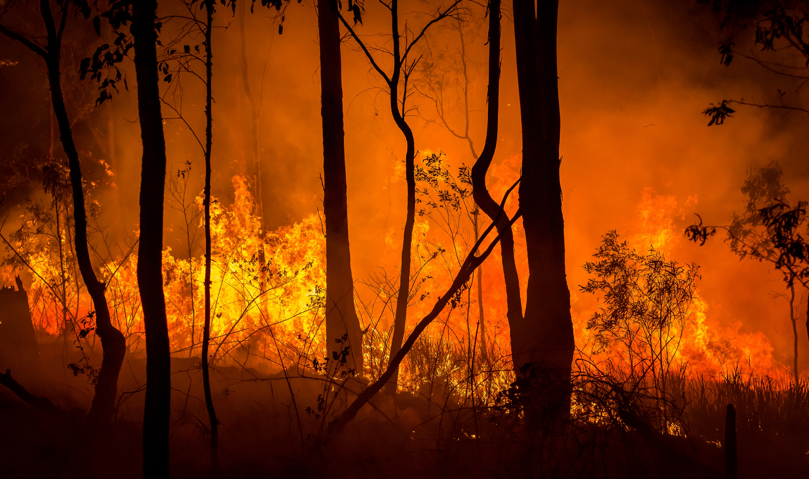
RFS volunteers and their employers
Volunteers provide fire and emergency preparation and response across Queensland.
Without their valuable skills, the prevention, preparedness, response and recovery of Queensland would be severely compromised.
The on-going support of employers to grant leave of absence and release our volunteers from their regular work duties is paramount.
Without employer support most communities would face greatly increased risks and more severe consequences from disasters.

Slide 5
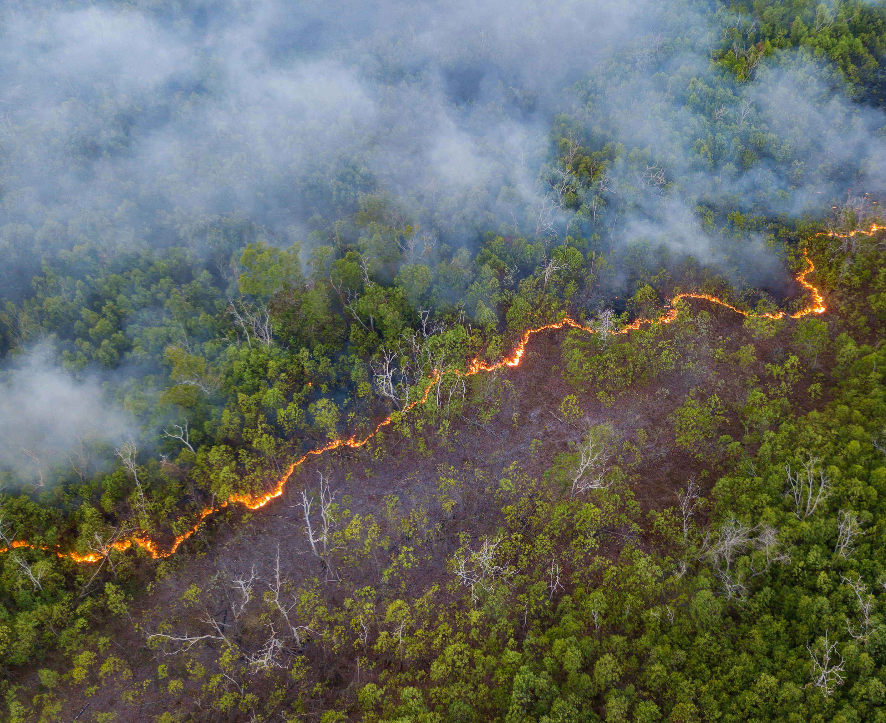
Employee leave
Volunteers should discuss release from work with their employer.
The discussion should determine what type of leave is to be used.
Arrangements may be informal (verbal) or formal (written).
The decision to release for leave is at the employer's discretion.
Notes:
RFS encourages its volunteers to discuss release from work and make suitable leave arrangements with their employers prior to the need to attend an emergency.
These arrangements may be informal, such as verbal or can be made more formally in writing.
The type of leave to be used should form part of these discussions. (Community Service Leave, Annual/Recreation Leave, Employer Special Leave, Leave without Pay).
The decision of when and how leave of absence may be granted and processed is at the discretion of the employer. (Consider the staffing and financial impacts on the business).

Slide 6
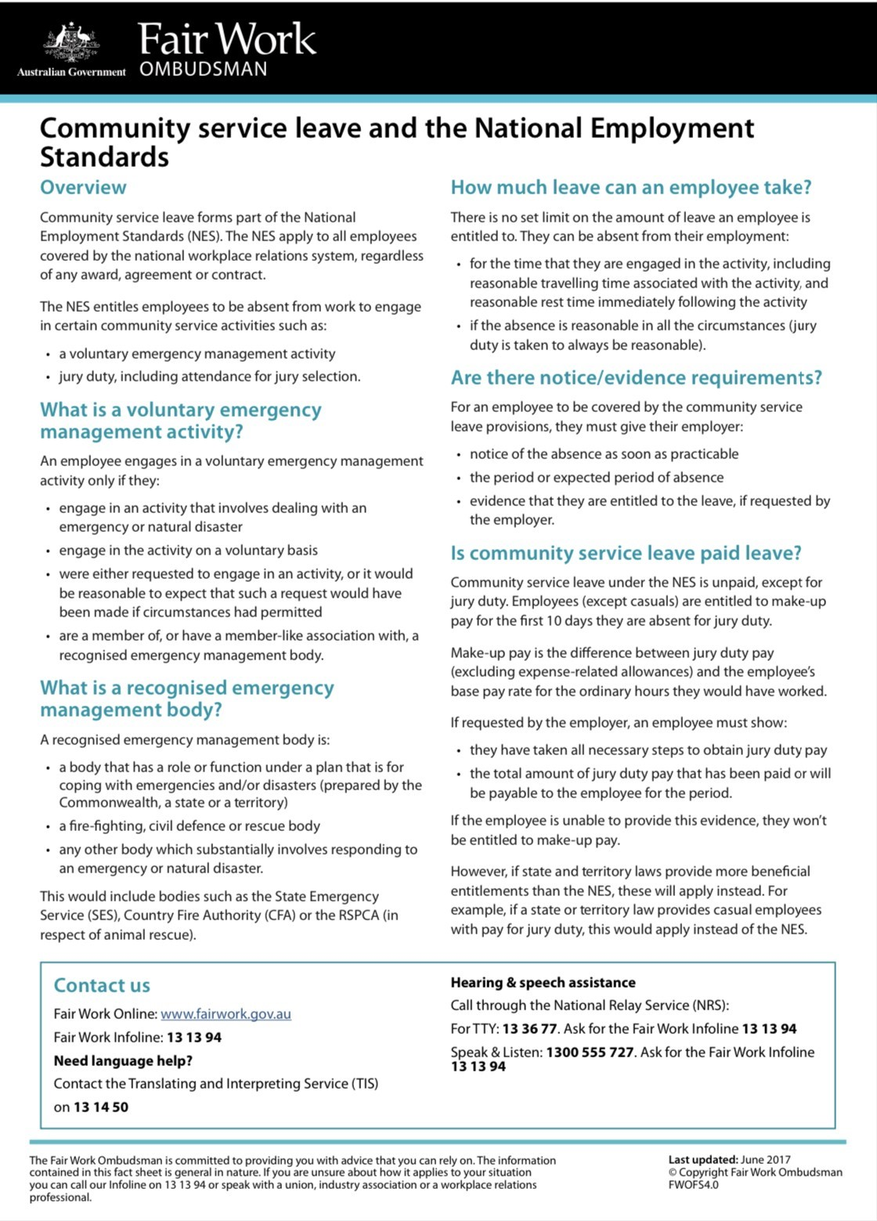
National Employment Standards – Community Service Leave Fact Sheet https://www.fairwork.gov.au/sites/default/files/migration/723/Community-service-leave.pdf
Notes:
Employers are encouraged to familiarise themselves with the legislative requirements to support emergency service volunteers, such as the Industrial Relations Act 1999 and the Fair Work Act 2009.
A detailed fact sheet is available from the Fair Work ombudsman.

Slide 7

Benefits
RFS volunteers make valuable employees and are equipped with a broad range of capabilities that are useful in the workplace:
working well in teams and following directions
communicating effectively
thinking on their feet
taking responsibility
using personal initiative
remaining calm in a crisis.
Notes:
RFS Volunteers undertake mandatory training and also have access to many knowledge and skills programs that enable them to develop transferable skills in a wide range of areas.
As well as a broad range of practical skills, many are also proficient in engaging and liaising with the community, taking decisive action under pressure and leading others.

Slide 8

Employer Incentives
Employers make a significant contribution to the community when releasing staff to respond to emergencies.
The Queensland Government recognises this through payroll tax exemptions for the hours staff spend away from work to assist in emergency operations.
For more information on payroll tax exemptions call the Queensland Revenue Office on 1300 300 734 during office hours or visit their website.
Notes:
RFS Volunteer Employers may be nominated for a QFES Employer Recognition Award by Volunteers to acknowledge their primary employer who has supported their RFS role with QFES.
Employer supportive actions for volunteers could include providing leave to attend emergencies, delivery of community education and/or undertake training.

Slide 9
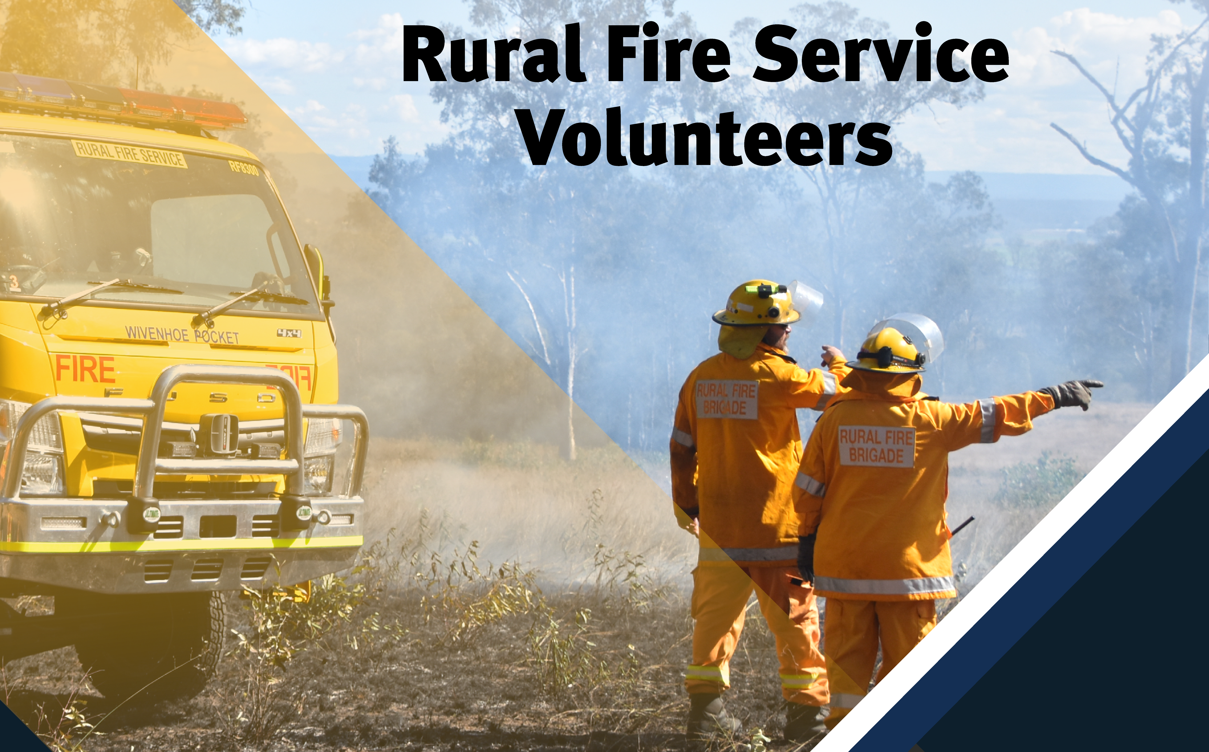
Want to know more ?
https://www.qfes.qld.gov.au/about-us/frontline-services/rural-fire-service

